Slide 1
EPFL Logic Synthesis Libraries
Heinz Riener
¹EPFL, Lausanne, Switzerland
BoF meeting 2019
Las Vegas, NV, USA
https://github.com/lsils/lstools-showcase
★ Star us at GitHub!

Slide 2
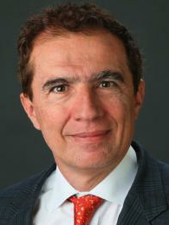
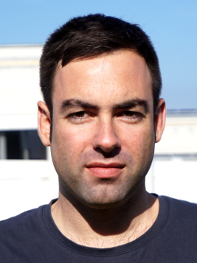
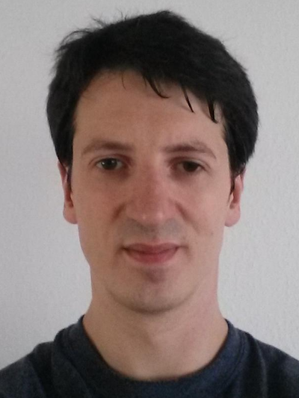
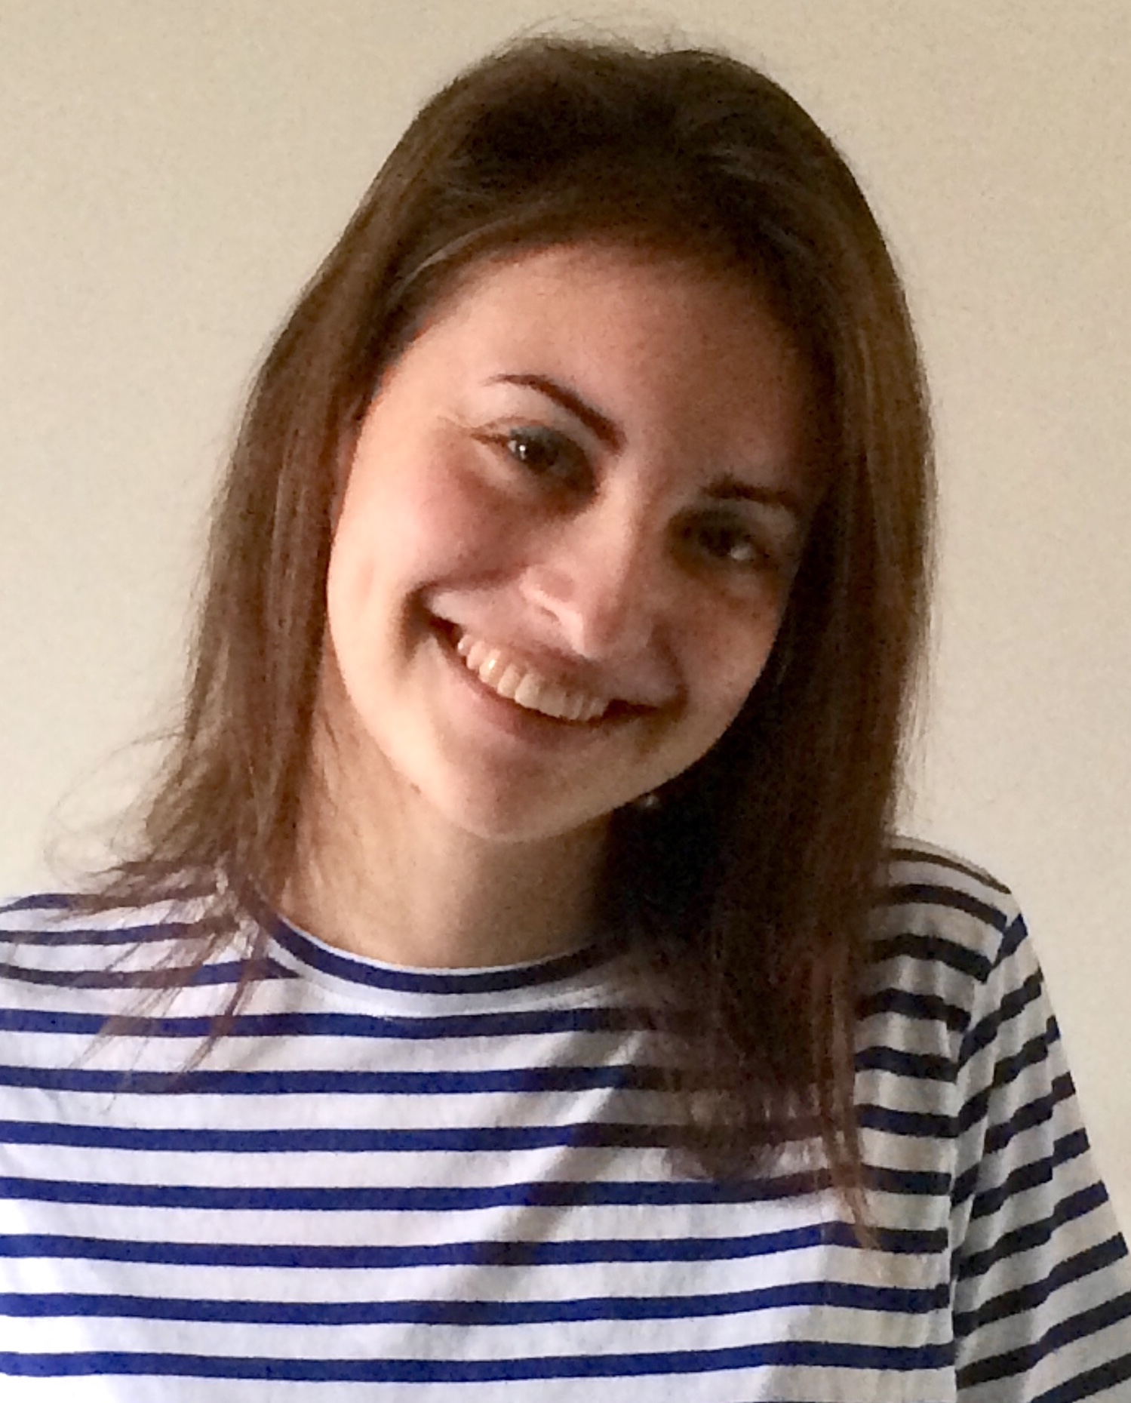
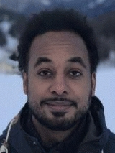
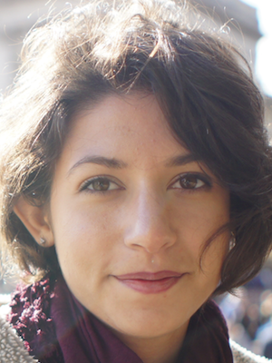
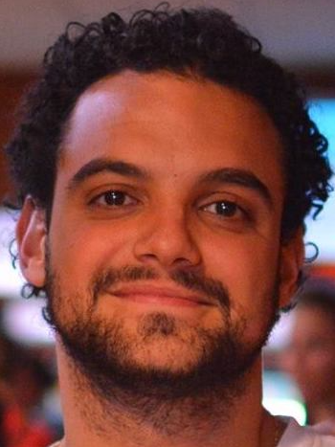
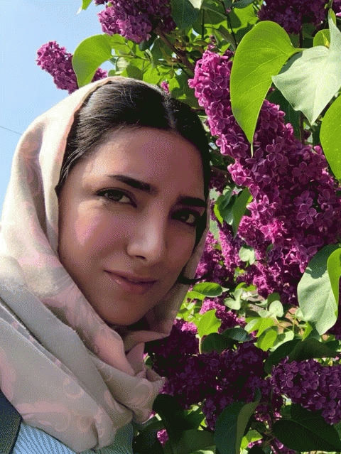
Team
Giovanni De Micheli
Mathias Soeken
Heinz Riener
Eleonora Testa
Winston Haaswijk
Giulia Meuli
Bruno Schmitt
Fereshte Mozafari

Slide 3








EPFL Logic Synthesis Libraries
Infrastructure for logic synthesis
Open source
Modular
Well tested
Well documented
percy:
exact synthesis lib.
mockturtle:
logic network lib.
lorina:
parsing lib.
alice:
command shell lib.
kitty:
truth table lib.
tweedledum:
quantum synth. lib.
easy:
ESOP lib.
caterpillar:
quantum comp. lib.
Mathias Soeken, Heinz Riener, Winston Haaswijk, and Giovanni De Micheli, The EPFL Logic Synthesis Libraries, Int’l Workshop on Logic Synthesis, arXiv:1805.05121, 2018.
URL: https://github.com/lsils/lstools-showcase

Slide 4

EPFL Logic Synthesis Libraries
Conventional logic synthesis
Infrastructure for logic synthesis
Open source
Modular
Well tested
Well documented
percy:
exact synthesis lib.
mockturtle:
logic network lib.
lorina:
parsing lib.
alice:
command shell lib.
kitty:
truth table lib.
tweedledum:
quantum synth. lib.
easy:
ESOP lib.
caterpillar:
quantum comp. lib.
Mathias Soeken, Heinz Riener, Winston Haaswijk, and Giovanni De Micheli, The EPFL Logic Synthesis Libraries, Int’l Workshop on Logic Synthesis, arXiv:1805.05121, 2018. URL: https://github.com/lsils/lstools-showcase

Slide 5
EPFL Logic Synthesis Libraries
Infrastructure for logic synthesis
Open source
Modular
Well tested
Well documented
percy:
exact synthesis lib.
mockturtle:
logic network lib.
lorina:
parsing lib.
alice:
command shell lib.
kitty:
truth table lib.
tweedledum:
quantum synth. lib.
easy:
ESOP lib.
caterpillar:
quantum comp. lib.
Quantum compilation
Mathias Soeken, Heinz Riener, Winston Haaswijk, and Giovanni De Micheli, The EPFL Logic Synthesis Libraries, Int’l Workshop on Logic Synthesis, arXiv:1805.05121, 2018. URL: https://github.com/lsils/lstools-showcase

Slide 6




EPFL libraries as research enabler
LSOracle
Modular software libraries in C++
State-of-the-art implementations
Well documented & tested
Header-only: easy to integrate
User can tackle complex research problems
Logic optimizations are used outside of the hardware design
Pre- & post-processing in constraint solving
Simplify verification problems
Analyze “hardness” of cryptographic circuits/logic encryption
Optimization in high-level synthesis (or reactive synthesis)
lgraph
fiction
z3

Slide 7
Dissemination events
Upcoming events:
June, 2019: Presentation at the Logic Synthesis Software School in Lausanne, Switzerland.
June, 2019: Presentation at the Week of Open Source Hardware in Zurich Switzerland.
Past events:
Feb., 2019: Presentation at FOSDEM CAD and Open Hardware devroom in Brussels, Belgium.
Nov., 2018: Presentation at the Workshop on Open-Source EDA Technology in San Diego, CA, USA.
Aug., 2018: Presentation at the IEEE CASS Seasonal School on Logic Synthesis in Porto Alegre, Brazil.
June, 2018: Presentation at the 27th International Workshop on Logic Synthesis in San Francisco, CA, USA.

Slide 8
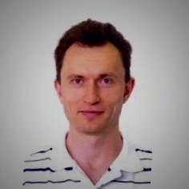
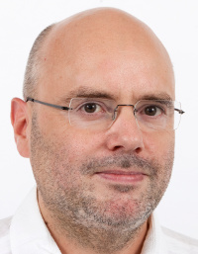
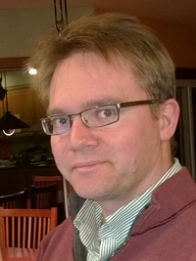
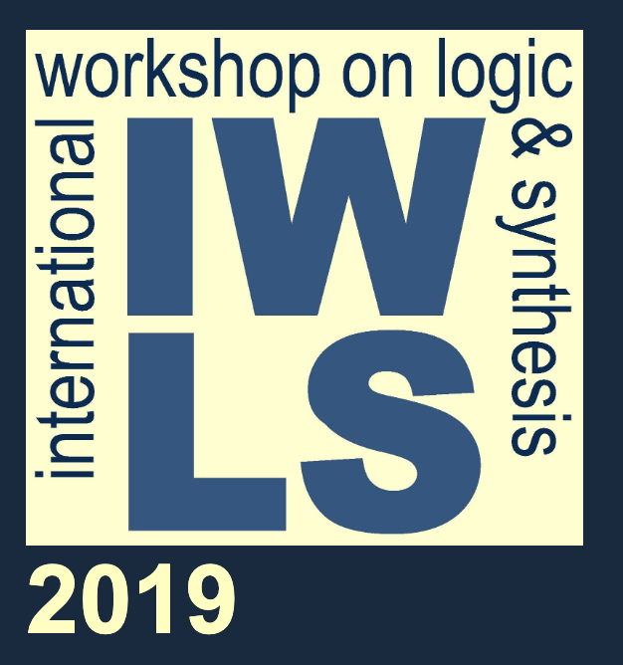
Logic Synthesis Software School
June, 20 • Lausanne, Switzerland
Co-located with IWLS in Lausanne, Switzerland
Focus on implementing logic synthesis tools
More information: http://www.iwls.org/lsss
Alan Mishchenko
LS & ABC
Heinz Riener
mockturtle
Armin Biere
Boolean SAT
Nikolaj Bjorner
SMT & z3

Slide 9
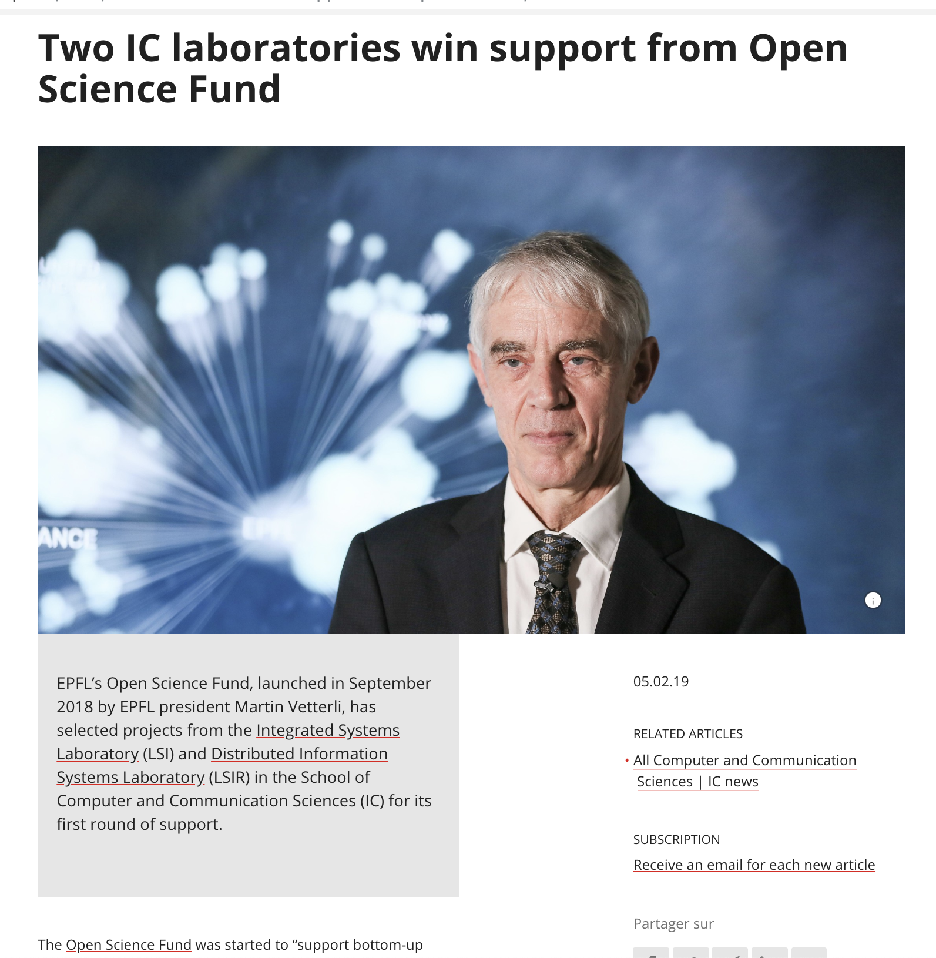
EPFL Open Science Fund
Supported by EPFL’s Open Science Fund
Unfettered dissemination of scientific discourse
Open source
Open access
Open benchmarks
Reproduceable results
Re-useable results
…

Slide 10
EPFL Logic Synthesis Libraries
Heinz Riener
¹EPFL, Lausanne, Switzerland
BoF meeting 2019
Las Vegas, NV, USA
https://github.com/lsils/lstools-showcase
★ Star us at GitHub!

